Slide 1
And the Dish Ran Away With the Spoon
Text Talk
Kindergarten, Unit 1
Old Wire Road Elementary

Slide 2
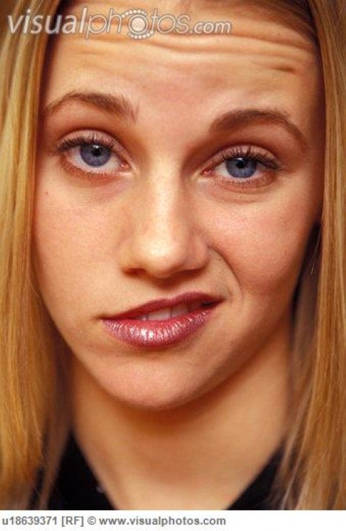
Smirked: to smile but not mean it.
The girl smirked when I told a joke. She did not think my joke was funny!

Slide 3
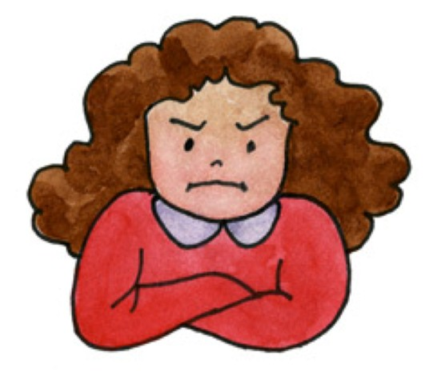
Grumbled: unhappy sounds or words coming out of your mouth (grrrr…..)
I grumbled all the way to school this morning.

Slide 4
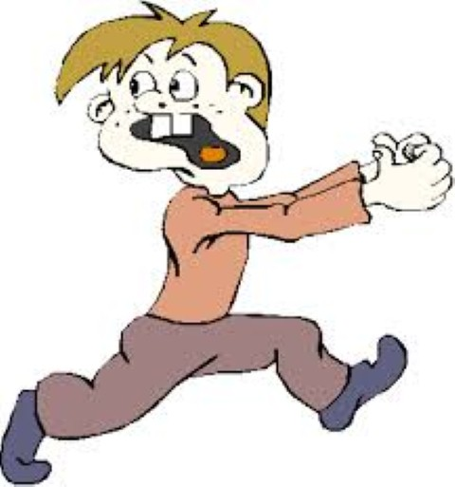
Bolted: ran away quickly
The man bolted when he saw the tiger!!

Slide 5
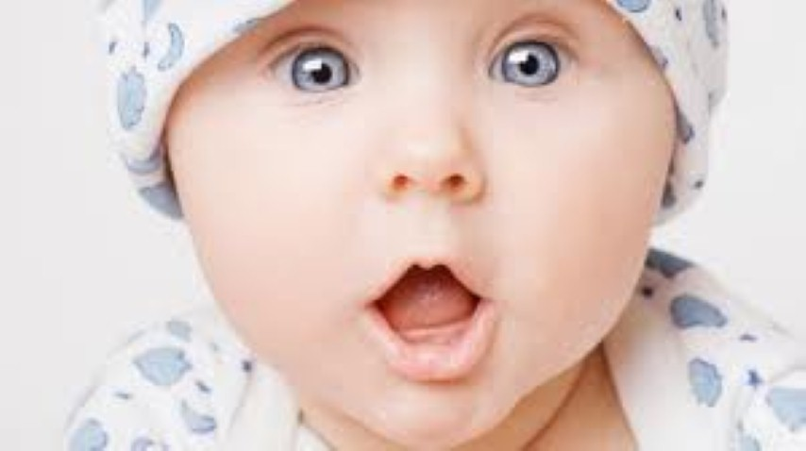
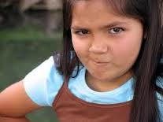
Which picture goes with smirked?

Slide 6
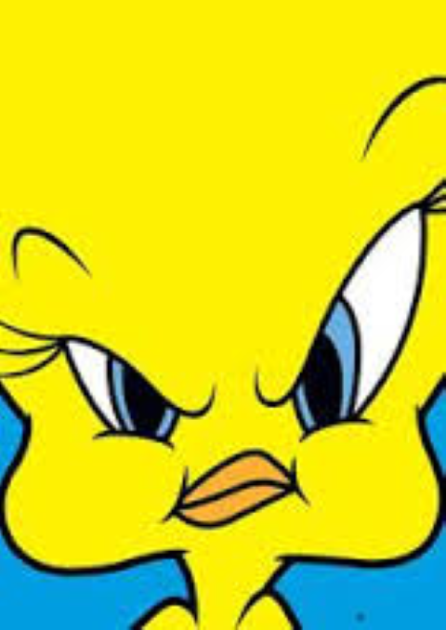
Which picture goes with grumbled?

Slide 7
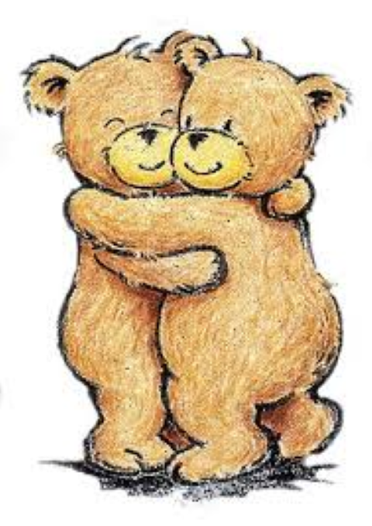
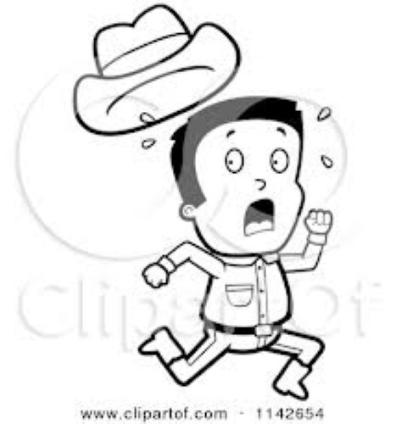
Which picture goes with bolted?

Slide 8
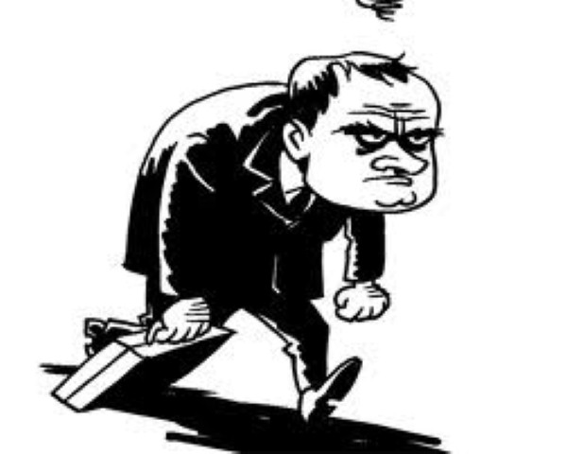
Which word does this picture go with: smirked, grumbled, bolted?

Slide 9
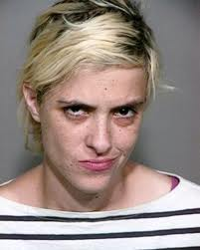
Which word does this picture go with: smirked, grumbled, bolted?

Slide 10
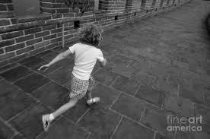
Which word does this picture go with: smirked, grumbled, bolted?

